Slide 1
Chapter 15: Security

Slide 2
Chapter 15: Security
The Security Problem
Program Threats
System and Network Threats
Cryptography as a Security Tool
User Authentication
Implementing Security Defenses
Firewalling to Protect Systems and Networks
Computer-Security Classifications
An Example: Windows

Slide 3
Objectives
To discuss security threats and attacks
To explain the fundamentals of encryption, authentication, and hashing
To examine the uses of cryptography in computing
To describe the various countermeasures to security attacks

Slide 4
The Security Problem
System secure if resources used and accessed as intended under all circumstances
Unachievable
Intruders (crackers) attempt to breach security
Threat is potential security violation
Attack is attempt to breach security
Attack can be accidental or malicious
Easier to protect against accidental than malicious misuse

Slide 5
Security Violation Categories
Breach of confidentiality
Unauthorized reading of data
Breach of integrity
Unauthorized modification of data
Breach of availability
Unauthorized destruction of data
Theft of service
Unauthorized use of resources
Denial of service (DOS)
Prevention of legitimate use

Slide 6
Security Violation Methods
Masquerading (breach authentication)
Pretending to be an authorized user to escalate privileges
Replay attack
As is or with message modification
Man-in-the-middle attack
Intruder sits in data flow, masquerading as sender to receiver and vice versa
Session hijacking
Intercept an already-established session to bypass authentication

Slide 7
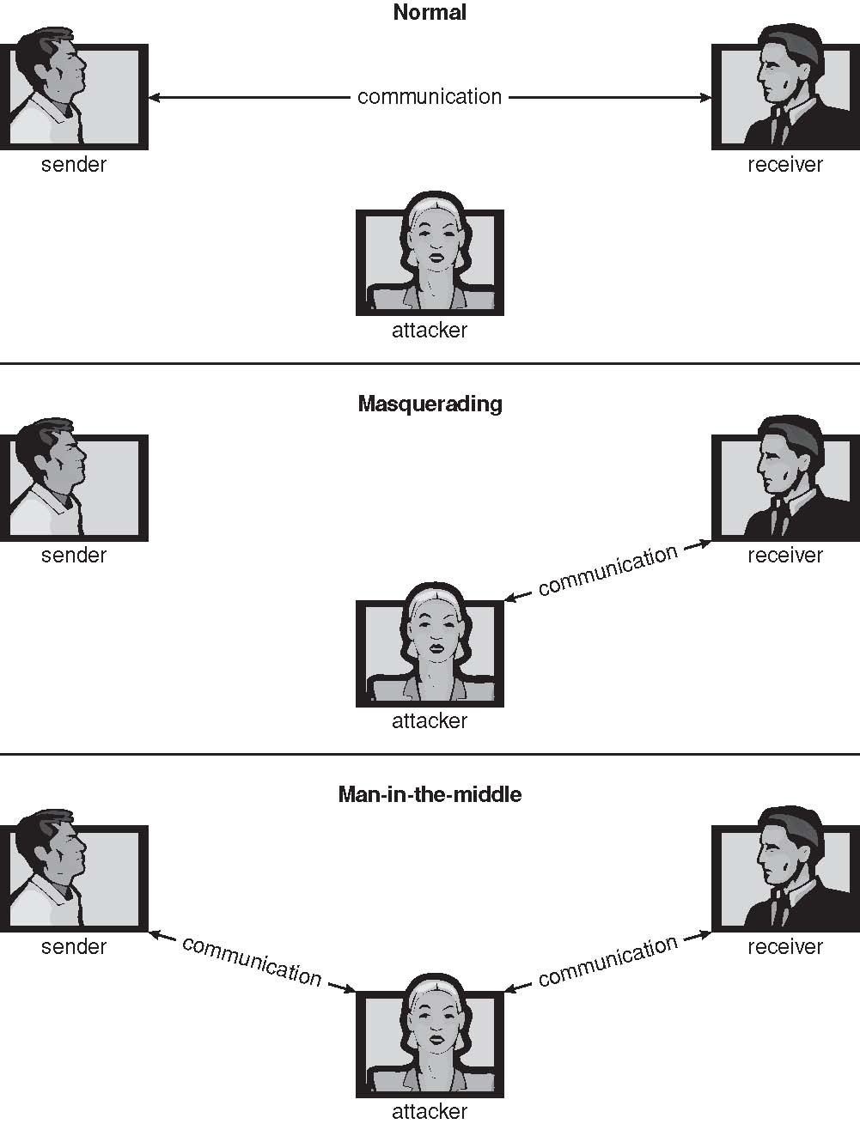
Standard Security Attacks

Slide 8
Security Measure Levels
Impossible to have absolute security, but make cost to perpetrator sufficiently high to deter most intruders
Security must occur at four levels to be effective:
Physical
Data centers, servers, connected terminals
Human
Avoid social engineering, phishing, dumpster diving
Operating System
Protection mechanisms, debugging
Network
Intercepted communications, interruption, DOS
Security is as weak as the weakest link in the chain
But can too much security be a problem?

Slide 9
Program Threats
Many variations, many names
Trojan Horse
Code segment that misuses its environment
Exploits mechanisms for allowing programs written by users to be executed by other users
Spyware, pop-up browser windows, covert channels
Up to 80% of spam delivered by spyware-infected systems
Trap Door
Specific user identifier or password that circumvents normal security procedures
Could be included in a compiler
How to detect them?

Slide 10
Program Threats (Cont.)
Logic Bomb
Program that initiates a security incident under certain circumstances
Stack and Buffer Overflow
Exploits a bug in a program (overflow either the stack or memory buffers)
Failure to check bounds on inputs, arguments
Write past arguments on the stack into the return address on stack
When routine returns from call, returns to hacked address
Pointed to code loaded onto stack that executes malicious code
Unauthorized user or privilege escalation

Slide 11
C Program with Buffer-overflow Condition
#include <stdio.h>
#define BUFFER SIZE 256
int main(int argc, char *argv[])
{
char buffer[BUFFER SIZE];
if (argc < 2)
return -1;
else {
strcpy(buffer,argv[1]);
return 0;
}
}

Slide 12
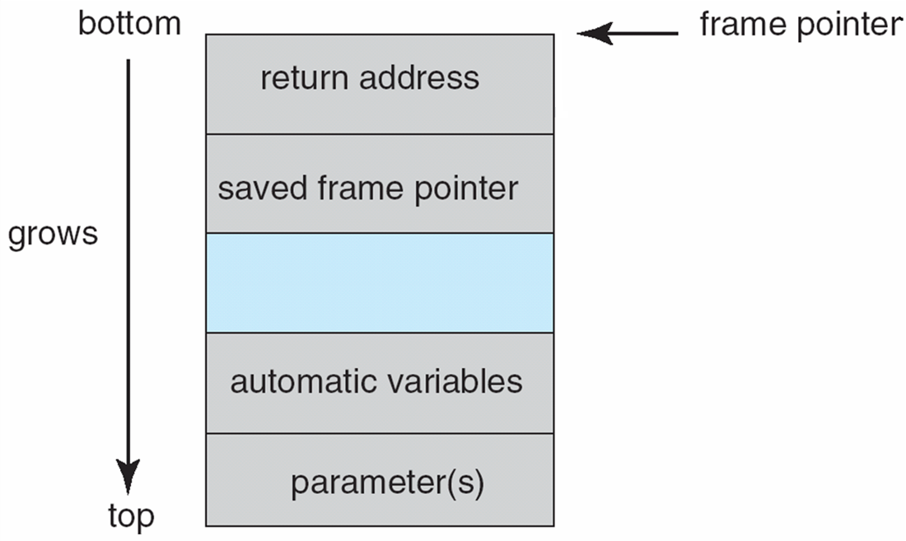
Layout of Typical Stack Frame

Slide 13
Modified Shell Code
#include <stdio.h>
int main(int argc, char *argv[])
{
execvp(‘‘\bin\sh’’,‘‘\bin \sh’’, NULL);
return 0;
}

Slide 14
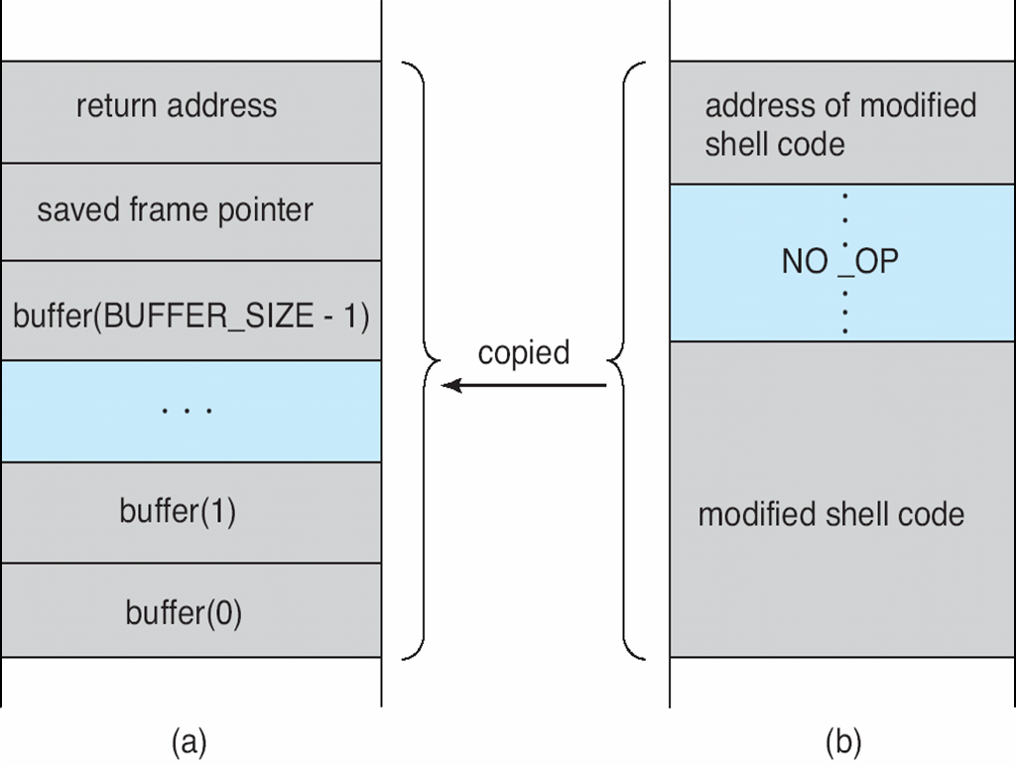
Hypothetical Stack Frame
Before attack
After attack

Slide 15
Great Programming Required?
For the first step of determining the bug, and second step of writing exploit code, yes
Script kiddies can run pre-written exploit code to attack a given system
Attack code can get a shell with the processes’ owner’s permissions
Or open a network port, delete files, download a program, etc
Depending on bug, attack can be executed across a network using allowed connections, bypassing firewalls
Buffer overflow can be disabled by disabling stack execution or adding bit to page table to indicate “non-executable” state
Available in SPARC and x86
But still have security exploits

Slide 16
Program Threats (Cont.)
Viruses
Code fragment embedded in legitimate program
Self-replicating, designed to infect other computers
Very specific to CPU architecture, operating system, applications
Usually borne via email or as a macro
Visual Basic Macro to reformat hard drive
Sub AutoOpen()
Dim oFS
Set oFS = CreateObject(’’Scripting.FileSystemObject’’)
vs = Shell(’’c:command.com /k format c:’’,vbHide)
End Sub

Slide 17
Program Threats (Cont.)
Virus dropper inserts virus onto the system
Many categories of viruses, literally many thousands of viruses
File / parasitic
Boot / memory
Macro
Source code
Polymorphic to avoid having a virus signature
Encrypted
Stealth
Tunneling
Multipartite
Armored

Slide 18
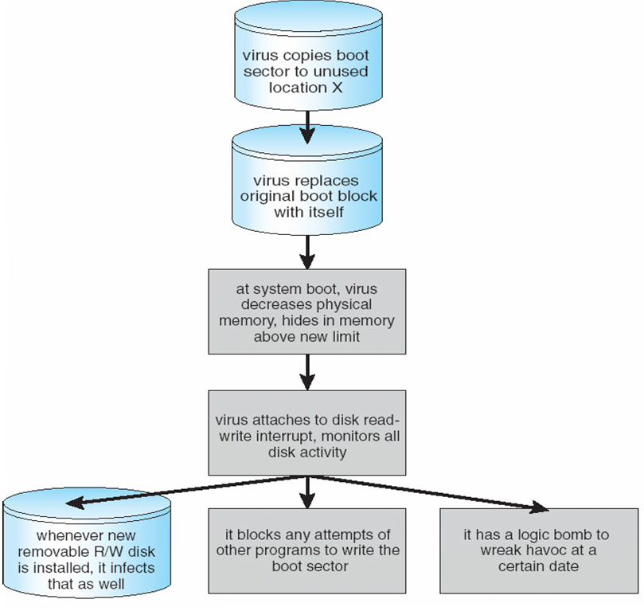
A Boot-sector Computer Virus

Slide 19
The Threat Continues
Attacks still common, still occurring
Attacks moved over time from science experiments to tools of organized crime
Targeting specific companies
Creating botnets to use as tool for spam and DDOS delivery
Keystroke logger to grab passwords, credit card numbers
Why is Windows the target for most attacks?
Most common
Everyone is an administrator
Licensing required?
Monoculture considered harmful

Slide 20
System and Network Threats
Some systems “open” rather than secure by default
Reduce attack surface
But harder to use, more knowledge needed to administer
Network threats harder to detect, prevent
Protection systems weaker
More difficult to have a shared secret on which to base access
No physical limits once system attached to internet
Or on network with system attached to internet
Even determining location of connecting system difficult
IP address is only knowledge

Slide 21
System and Network Threats (Cont.)
Worms – use spawn mechanism; standalone program
Internet worm
Exploited UNIX networking features (remote access) and bugs in finger and sendmail programs
Exploited trust-relationship mechanism used by rsh to access friendly systems without use of password
Grappling hook program uploaded main worm program
99 lines of C code
Hooked system then uploaded main code, tried to attack connected systems
Also tried to break into other users accounts on local system via password guessing
If target system already infected, abort, except for every 7th time

Slide 22
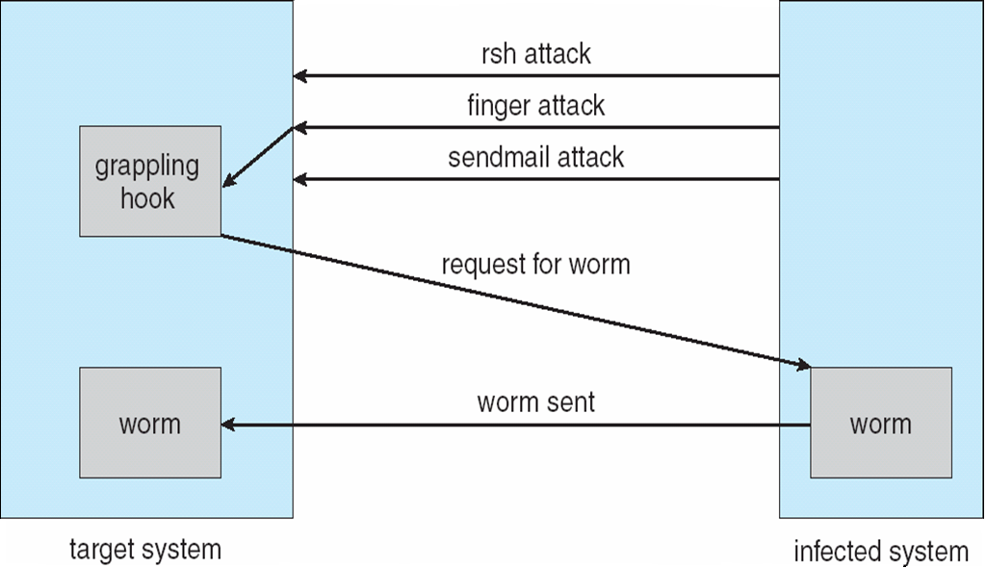
The Morris Internet Worm

Slide 23
System and Network Threats (Cont.)
Port scanning
Automated attempt to connect to a range of ports on one or a range of IP addresses
Detection of answering service protocol
Detection of OS and version running on system
nmap scans all ports in a given IP range for a response
nessus has a database of protocols and bugs (and exploits) to apply against a system
Frequently launched from zombie systems
To decrease trace-ability

Slide 24
System and Network Threats (Cont.)
Denial of Service
Overload the targeted computer preventing it from doing any useful work
Distributed denial-of-service (DDOS) come from multiple sites at once
Consider the start of the IP-connection handshake (SYN)
How many started-connections can the OS handle?
Consider traffic to a web site
How can you tell the difference between being a target and being really popular?
Accidental – CS students writing bad fork() code
Purposeful – extortion, punishment

Slide 25
Sobig.F Worm
More modern example
Disguised as a photo uploaded to adult newsgroup via account created with stolen credit card
Targeted Windows systems
Had own SMTP engine to mail itself as attachment to everyone in infect system’s address book
Disguised with innocuous subject lines, looking like it came from someone known
Attachment was executable program that created WINPPR23.EXE in default Windows system directory Plus the Windows Registry [HKCU\SOFTWARE\Microsoft\Windows\CurrentVersion\Run] "TrayX" = %windir%\winppr32.exe /sinc [HKLM\SOFTWARE\Microsoft\Windows\CurrentVersion\Run] "TrayX" = %windir%\winppr32.exe /sinc

Slide 26
Cryptography as a Security Tool
Broadest security tool available
Internal to a given computer, source and destination of messages can be known and protected
OS creates, manages, protects process IDs, communication ports
Source and destination of messages on network cannot be trusted without cryptography
Local network – IP address?
Consider unauthorized host added
WAN / Internet – how to establish authenticity
Not via IP address

Slide 27
Cryptography
Means to constrain potential senders (sources) and / or receivers (destinations) of messages
Based on secrets (keys)
Enables
Confirmation of source
Receipt only by certain destination
Trust relationship between sender and receiver

Slide 28
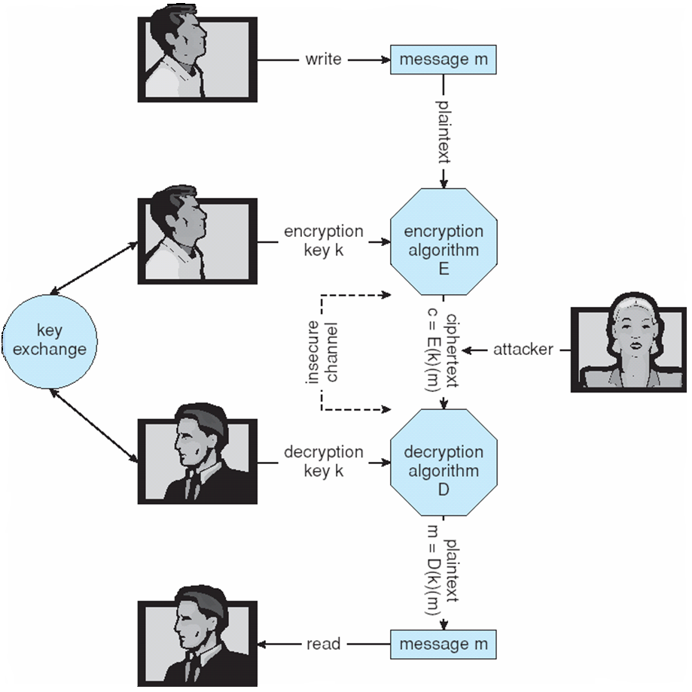
Secure Communication over Insecure Medium

Slide 29
Encryption
Encryption algorithm consists of
Set K of keys
Set M of Messages
Set C of ciphertexts (encrypted messages)
A function E : K → (M→C). That is, for each k ∈ K, E(k) is a function for generating ciphertexts from messages
Both E and E(k) for any k should be efficiently computable functions
A function D : K → (C → M). That is, for each k ∈ K, D(k) is a function for generating messages from ciphertexts
Both D and D(k) for any k should be efficiently computable functions
An encryption algorithm must provide this essential property: Given a ciphertext c ∈ C, a computer can compute m such that E(k)(m) = c only if it possesses D(k)
Thus, a computer holding D(k) can decrypt ciphertexts to the plaintexts used to produce them, but a computer not holding D(k) cannot decrypt ciphertexts
Since ciphertexts are generally exposed (for example, sent on the network), it is important that it be infeasible to derive D(k) from the ciphertexts

Slide 30
Symmetric Encryption
Same key used to encrypt and decrypt
E(k) can be derived from D(k), and vice versa
DES is most commonly used symmetric block-encryption algorithm (created by US Govt)
Encrypts a block of data at a time
Triple-DES considered more secure
Advanced Encryption Standard (AES), twofish up and coming
RC4 is most common symmetric stream cipher, but known to have vulnerabilities
Encrypts/decrypts a stream of bytes (i.e., wireless transmission)
Key is a input to psuedo-random-bit generator
Generates an infinite keystream

Slide 31
Asymmetric Encryption
Public-key encryption based on each user having two keys:
public key – published key used to encrypt data
private key – key known only to individual user used to decrypt data
Must be an encryption scheme that can be made public without making it easy to figure out the decryption scheme
Most common is RSA block cipher
Efficient algorithm for testing whether or not a number is prime
No efficient algorithm is know for finding the prime factors of a number

Slide 32
Asymmetric Encryption (Cont.)
Formally, it is computationally infeasible to derive D(k_{d} , N) from E(k_{e} , N), and so E(k_{e} , N) need not be kept secret and can be widely disseminated
E(k_{e} , N) (or just k_{e}) is the public key
D(k_{d} , N) (or just k_{d}) is the private key
N is the product of two large, randomly chosen prime numbers p and q (for example, p and q are 512 bits each)
Encryption algorithm is E(k_{e} , N)(m) = m^{ke} mod N, where k_{e} satisfies k_{e}k_{d} mod (p−1)(q −1) = 1
The decryption algorithm is then D(k_{d} , N)(c) = c^{kd} mod N

Slide 33
Asymmetric Encryption Example
For example. make p = 7and q = 13
We then calculate N = 7∗13 = 91 and (p−1)(q−1) = 72
We next select k_{e} relatively prime to 72 and< 72, yielding 5
Finally,we calculate k_{d} such that k_{e}k_{d} mod 72 = 1, yielding 29
We how have our keys
Public key, k_{e,} N = 5, 91
Private key, k_{d} , N = 29, 91
Encrypting the message 69 with the public key results in the cyphertext 62
Cyphertext can be decoded with the private key
Public key can be distributed in cleartext to anyone who wants to communicate with holder of public key

Slide 34
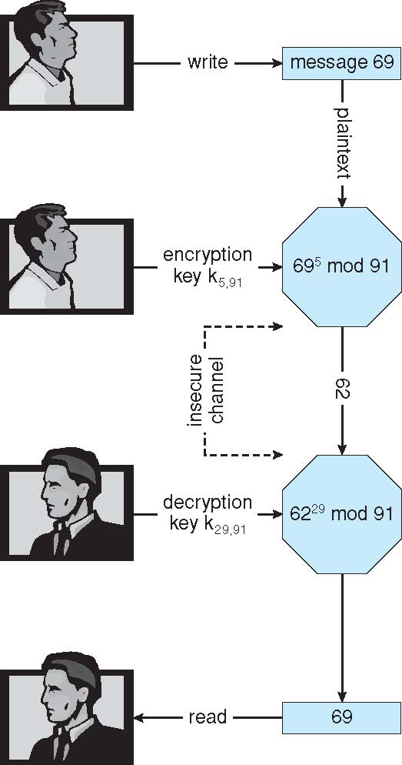
Encryption and Decryption using RSA Asymmetric Cryptography

Slide 35
Cryptography (Cont.)
Note symmetric cryptography based on transformations, asymmetric based on mathematical functions
Asymmetric much more compute intensive
Typically not used for bulk data encryption

Slide 36
Authentication
Constraining set of potential senders of a message
Complementary and sometimes redundant to encryption
Also can prove message unmodified
Algorithm components
A set K of keys
A set M of messages
A set A of authenticators
A function S : K → (M→ A)
That is, for each k ∈ K, S(k) is a function for generating authenticators from messages
Both S and S(k) for any k should be efficiently computable functions
A function V : K → (M× A→ {true, false}). That is, for each k ∈ K, V(k) is a function for verifying authenticators on messages
Both V and V(k) for any k should be efficiently computable functions

Slide 37
Authentication (Cont.)
For a message m, a computer can generate an authenticator a ∈ A such that V(k)(m, a) = true only if it possesses S(k)
Thus, computer holding S(k) can generate authenticators on messages so that any other computer possessing V(k) can verify them
Computer not holding S(k) cannot generate authenticators on messages that can be verified using V(k)
Since authenticators are generally exposed (for example, they are sent on the network with the messages themselves), it must not be feasible to derive S(k) from the authenticators

Slide 38
Authentication – Hash Functions
Basis of authentication
Creates small, fixed-size block of data (message digest, hash value) from m
Hash Function H must be collision resistant on m
Must be infeasible to find an m’ ≠ m such that H(m) = H(m’)
If H(m) = H(m’), then m = m’
The message has not been modified
Common message-digest functions include MD5, which produces a 128-bit hash, and SHA-1, which outputs a 160-bit hash

Slide 39
Authentication - MAC
Symmetric encryption used in message-authentication code (MAC) authentication algorithm
Simple example:
MAC defines S(k)(m) = f (k, H(m))
Where f is a function that is one-way on its first argument
k cannot be derived from f (k, H(m))
Because of the collision resistance in the hash function, reasonably assured no other message could create the same MAC
A suitable verification algorithm is V(k)(m, a) ≡ ( f (k,m) = a)
Note that k is needed to compute both S(k) and V(k), so anyone able to compute one can compute the other

Slide 40
Authentication – Digital Signature
Based on asymmetric keys and digital signature algorithm
Authenticators produced are digital signatures
In a digital-signature algorithm, computationally infeasible to derive S(k_{s} ) from V(k_{v})
V is a one-way function
Thus, k_{v} is the public key and k_{s} is the private key
Consider the RSA digital-signature algorithm
Similar to the RSA encryption algorithm, but the key use is reversed
Digital signature of message S(k_{s} )(m) = H(m)^{ks} mod N
The key k_{s} again is a pair d, N, where N is the product of two large, randomly chosen prime numbers p and q
Verification algorithm is V(k_{v})(m, a) ≡ (a^{kv} mod N = H(m))
Where k_{v} satisfies k_{v}k_{s} mod (p − 1)(q − 1) = 1

Slide 41
Authentication (Cont.)
Why authentication if a subset of encryption?
Fewer computations (except for RSA digital signatures)
Authenticator usually shorter than message
Sometimes want authentication but not confidentiality
Signed patches et al
Can be basis for non-repudiation

Slide 42
Key Distribution
Delivery of symmetric key is huge challenge
Sometimes done out-of-band
Asymmetric keys can proliferate – stored on key ring
Even asymmetric key distribution needs care – man-in-the-middle attack

Slide 43
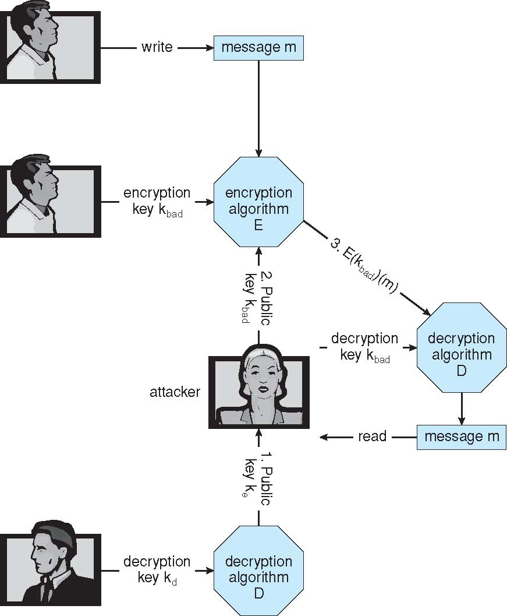
Man-in-the-middle Attack on Asymmetric Cryptography

Slide 44
Digital Certificates
Proof of who or what owns a public key
Public key digitally signed a trusted party
Trusted party receives proof of identification from entity and certifies that public key belongs to entity
Certificate authority are trusted party – their public keys included with web browser distributions
They vouch for other authorities via digitally signing their keys, and so on

Slide 45
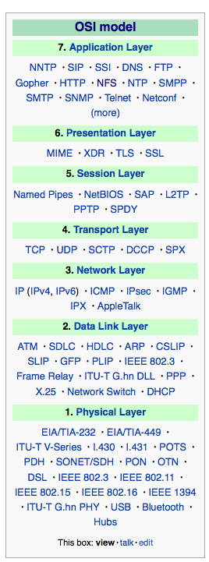
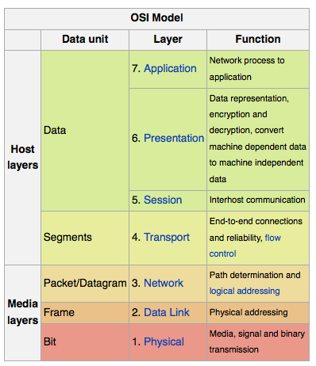
Implementation of Cryptography
Can be done at various levels of ISO Reference Model
SSL at the Transport layer
Network layer is typically IPSec
IKE for key exchange
Basis of VPNs
Why not just at lowest level?
Sometimes need more knowledge than available at low levels
i.e. User authentication
i.e. e-mail delivery
Source: http://en.wikipedia.org/wiki/OSI_model

Slide 46
Encryption Example - SSL
Insertion of cryptography at one layer of the ISO network model (the transport layer)
SSL – Secure Socket Layer (also called TLS)
Cryptographic protocol that limits two computers to only exchange messages with each other
Very complicated, with many variations
Used between web servers and browsers for secure communication (credit card numbers)
The server is verified with a certificate assuring client is talking to correct server
Asymmetric cryptography used to establish a secure session key (symmetric encryption) for bulk of communication during session
Communication between each computer then uses symmetric key cryptography

Slide 47
User Authentication
Crucial to identify user correctly, as protection systems depend on user ID
User identity most often established through passwords, can be considered a special case of either keys or capabilities
Passwords must be kept secret
Frequent change of passwords
History to avoid repeats
Use of “non-guessable” passwords
Log all invalid access attempts (but not the passwords themselves)
Unauthorized transfer
Passwords may also either be encrypted or allowed to be used only once
Does encrypting passwords solve the exposure problem?
Might solve sniffing
Consider shoulder surfing
Consider Trojan horse keystroke logger
How are passwords stored at authenticating site?

Slide 48
Passwords
Encrypt to avoid having to keep secret
But keep secret anyway (i.e. Unix uses superuser-only readably file /etc/shadow)
Use algorithm easy to compute but difficult to invert
Only encrypted password stored, never decrypted
Add “salt” to avoid the same password being encrypted to the same value
One-time passwords
Use a function based on a seed to compute a password, both user and computer
Hardware device / calculator / key fob to generate the password
Changes very frequently
Biometrics
Some physical attribute (fingerprint, hand scan)
Multi-factor authentication
Need two or more factors for authentication
i.e. USB “dongle”, biometric measure, and password

Slide 49
Implementing Security Defenses
Defense in depth is most common security theory – multiple layers of security
Security policy describes what is being secured
Vulnerability assessment compares real state of system / network compared to security policy
Intrusion detection endeavors to detect attempted or successful intrusions
Signature-based detection spots known bad patterns
Anomaly detection spots differences from normal behavior
Can detect zero-day attacks
False-positives and false-negatives a problem
Virus protection
Auditing, accounting, and logging of all or specific system or network activities

Slide 50
Firewalling to Protect Systems and Networks
A network firewall is placed between trusted and untrusted hosts
The firewall limits network access between these two security domains
Can be tunneled or spoofed
Tunneling allows disallowed protocol to travel within allowed protocol (i.e., telnet inside of HTTP)
Firewall rules typically based on host name or IP address which can be spoofed
Personal firewall is software layer on given host
Can monitor / limit traffic to and from the host
Application proxy firewall understands application protocol and can control them (i.e., SMTP)
System-call firewall monitors all important system calls and apply rules to them (i.e., this program can execute that system call)

Slide 51
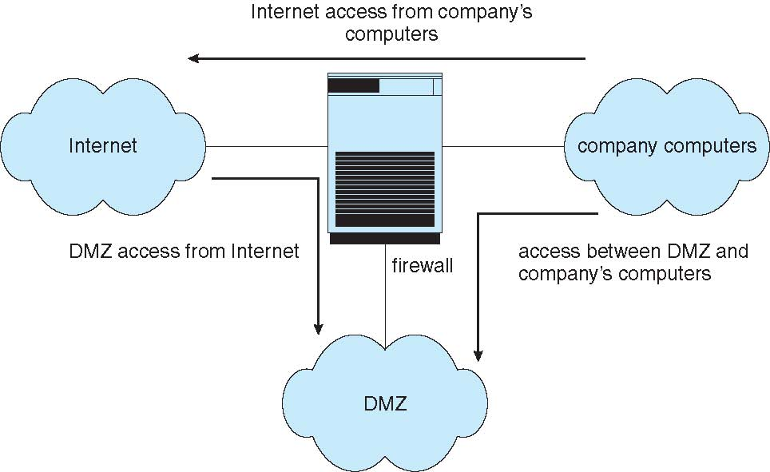
Network Security Through Domain Separation Via Firewall

Slide 52
Computer Security Classifications
U.S. Department of Defense outlines four divisions of computer security: A, B, C, and D
D – Minimal security
C – Provides discretionary protection through auditing
Divided into C1 and C2
C1 identifies cooperating users with the same level of protection
C2 allows user-level access control
B – All the properties of C, however each object may have unique sensitivity labels
Divided into B1, B2, and B3
A – Uses formal design and verification techniques to ensure security

Slide 53
Example: Windows
Security is based on user accounts
Each user has unique security ID
Login to ID creates security access token
Includes security ID for user, for user’s groups, and special privileges
Every process gets copy of token
System checks token to determine if access allowed or denied
Uses a subject model to ensure access security
A subject tracks and manages permissions for each program that a user runs
Each object in Windows has a security attribute defined by a security descriptor
For example, a file has a security descriptor that indicates the access permissions for all users

Slide 54
End of Chapter 15

